Slide 1

Final Engagement
Attack, Defense & Analysis of a Vulnerable Network
Presentators: Komal, Andrew, Lax, Mini, and Santiago

Slide 2
Table of Contents
This document contains the following resources:
Network Topology & Critical Vulnerabilities
Alerts Implemented
Hardening
Implementing Patches

Slide 3
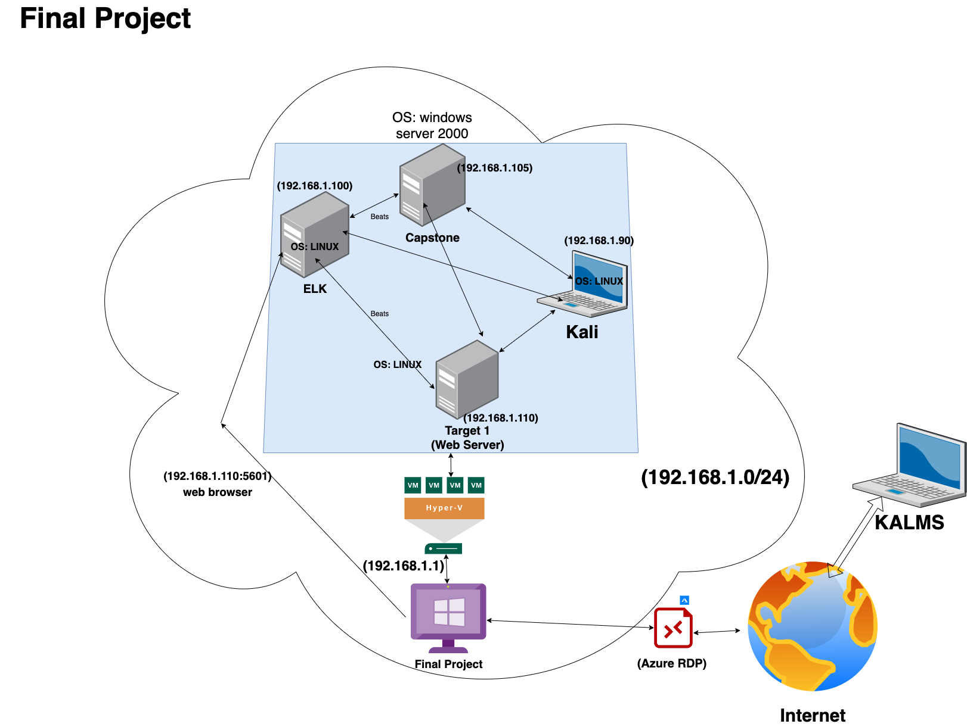
Network Topology
Network
Address Range:192.168.1.0/24
Netmask:255.255.255.0
Gateway:192.168.1.1
Machines
IPv4:192.168.1.100
OS: Linux
Hostname: ELK
IPv4:192.168.1.110
OS: Linux
Hostname: Target 1
IPv4:192.168.1.105
OS: Windows
Hostname: Capstone
IPv4:192.168.1.90
OS: Kali Linux
Hostname: Kali
Notes:
Here is the network topology diagram. In our network, there were 4 virtual machines, they are The ELK, Target 1, Capstone and Kali.
The Elk monitor

Slide 4
Critical Vulnerabilities: Target 1
Our assessment uncovered the following critical vulnerabilities in Target 1.
Vulnerability | Description | Impact
CWE-400 | DDOS | Crash, Exit, or Restart; DoS: Resource Consumption (CPU); DoS: Resource Consumption (Memory); DoS: Resource Consumption (Other)
CWE-307 | Brute force attack | An attacker could perform an arbitrary number of authentication attempts using different passwords, and eventually gain access to the targeted account.
CWE-89 | SQL Injection | Since SQL databases generally hold sensitive data, loss of confidentiality is a frequent problem with SQL injection vulnerabilities.
CWE - 22 | File Inclusion Exploits | File inclusion exploits happen when vulnerable PHP code is used to load remote files that are in the server. File inclusion exploits are one of the most common ways an attacker can gain access to wp-config.php which is in fact the WordPress configuration file.

Slide 5
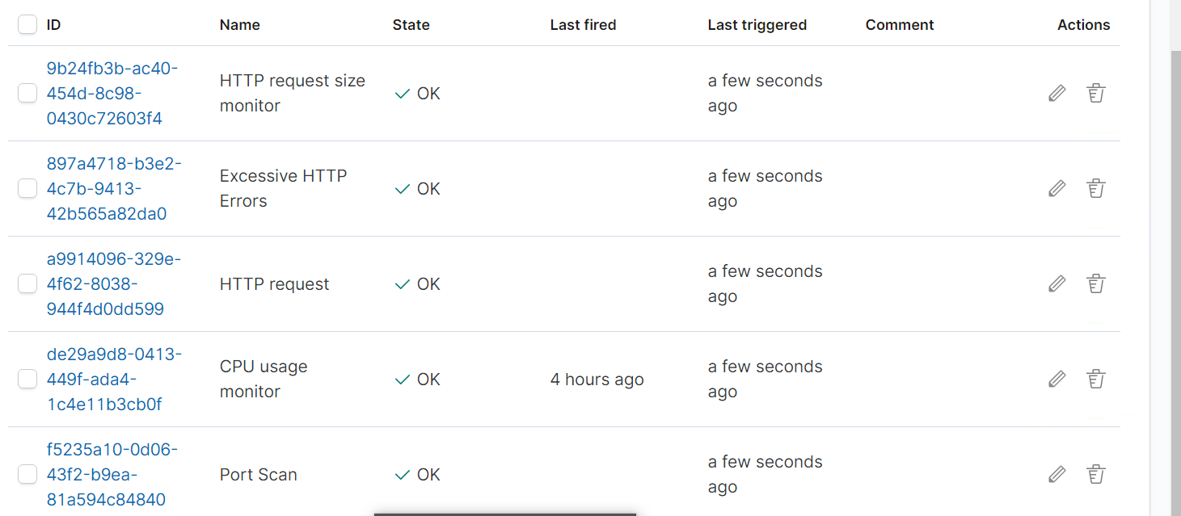
Excessive HTTP Errors
Queries packetbeat indices for http status code responses
Metric : Packetbeat
What is the threshold it fires at? Triggers when the grouped count over top 5 https status response code exceeds 400 in the last 5 minutes
Notes:
The first threshold alert implemented was Excessive HTTP errors, which queries packetbeat indices for HTTP status code responses
the threshold was triggered when the top 5 http response codes were over 400 in the last 5 minutes

Slide 6
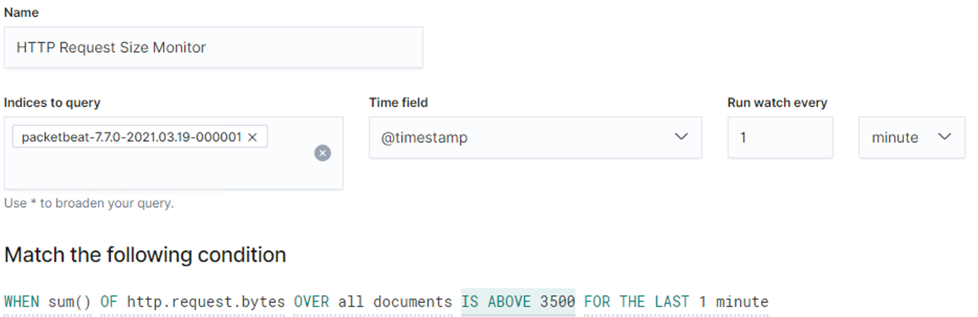
HTTP Request Size
Metric: Packetbeat-7.7.0-2021.03.19-000001
Threshold: Total Http requests bytes is above 3500 for last minute.
and when fired:
Notes:
The second Threshold Alert was the HTTP request size and its metric was again packetbeat, which monitors HTTP traffic.
The alert was triggered when the total HHTP requests bytes were above 3500 in the last minute.

Slide 7
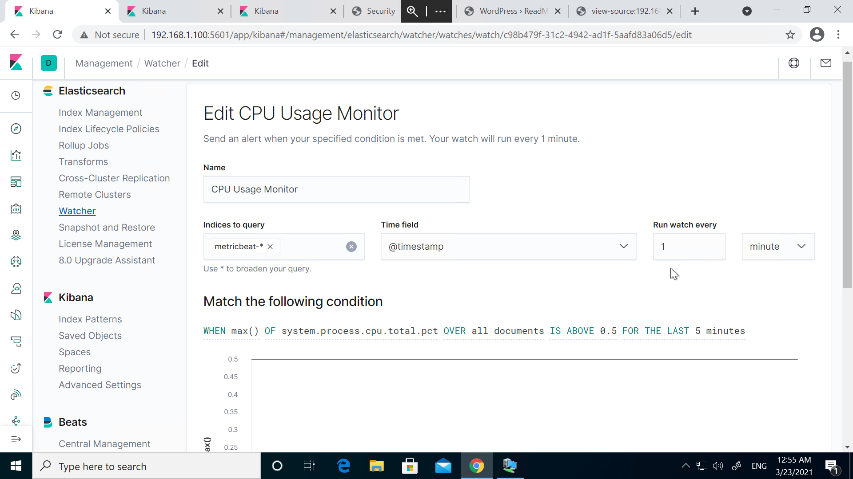
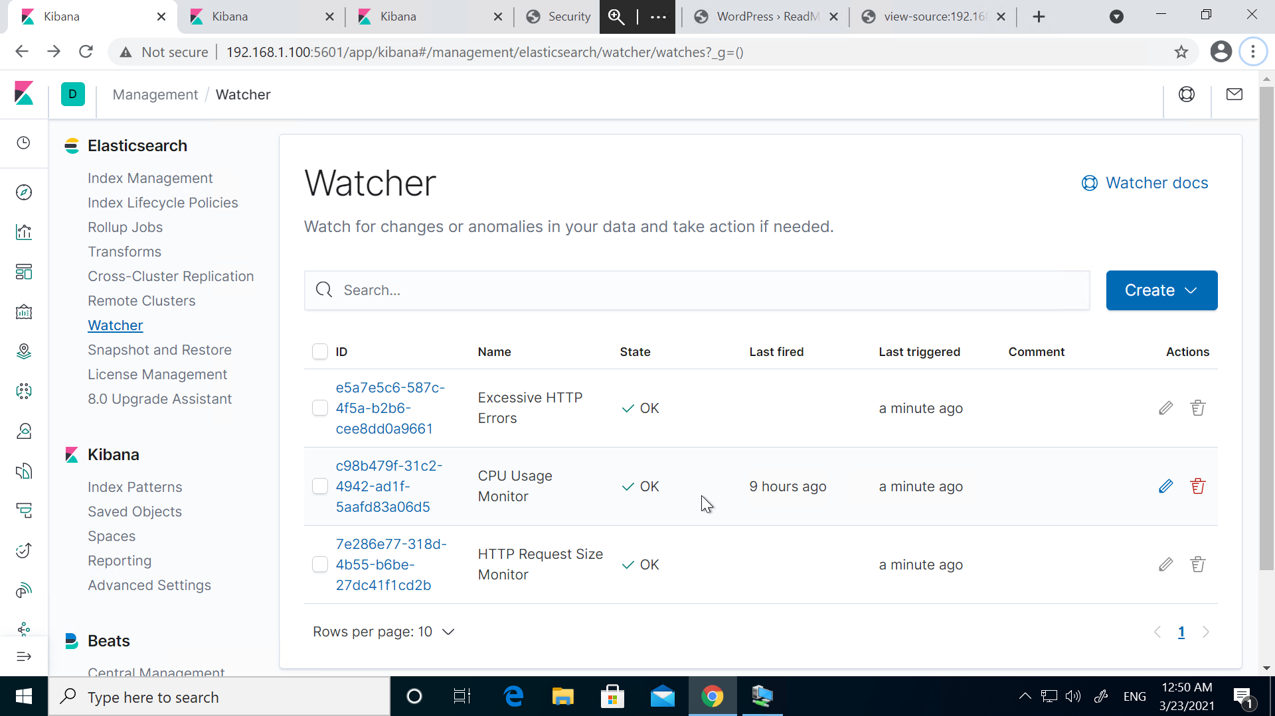
CPU Usage Monitor
Metric: Metricbeat
Threshold: When max() of system.process.cpu.total.pct over all documents is above 0.5 for the last 5 minutes
Notes:
1)The last threshold alert was the CPU usagage monitor. It’s metric was metricbeat and it was triggered when the system process of the cpu was over 0.5 for the last 5 minutes

Slide 8


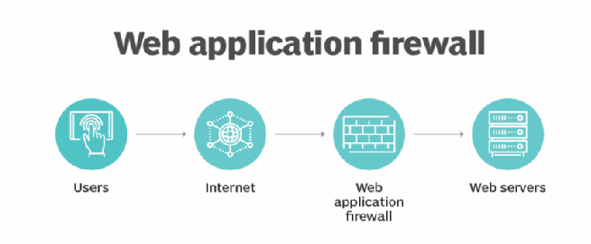
Hardening Against Brute-Force Attack on Target 1
Patch: Ensure passwords are complex, use two factor authentication, and make the root user inaccessible via SSH
Why It Works: Complex passwords are harder to guess and take much longer to guess. Using two factor authentication makes it much harder for malicious parties to get access to the clients server and finally, hackers that can log in to the server through roots account via SSH can cause damage and so it saves trouble to disallow root access via SSH
How to install it :
nano /etc/ssh/sshd_config
(change) #PermitRootLogin yes (to) PermitRootLogin no
/etc/init.d/sshd restart
systemctl restart sshd
service sshd restart
Notes:
You can also harden against a lot of attacks by installing a web application firewall.

Slide 9
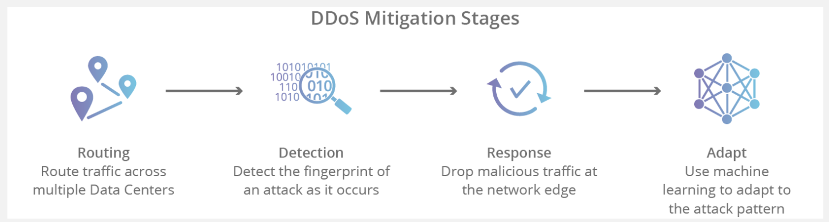
Hardening Against Spike in HTTP Request Size (DDOS) on Target 1
Vulnerability: DDOS Attack
Patch: There are no reliable patches or software updates that have been proven to control DDOS attacks but there are DDoS mitigation services, e.g cloudflare.
Why It Works: DDOS mitigation services, detect suspected DDOS attacks, reroute them, and use machine learning to adapt to the attack pattern. There are so many services offering this real time DDOS protection but for a price of $20/month minimum.

Slide 10
Hardening Against CPU Excess Usage on Target 1
Patch Commands
sudo apt update && sudo apt -y upgrade (Update/Upgrade Software)
sudo apt purge application (Removing and Re-Installing apps)
sudo apt update
sudo apt install application
Some of the issue to high CPU usage can be related to not updated/upgraded software that might have new patches that make the software more efficient. Another problem could be improperly installed code. By using the patch above one can update all the system software. If this does not work then we can move on by uninstalling and reinstalling the given program, to see if the issue was a problem in the way it was originally installed.

Slide 11
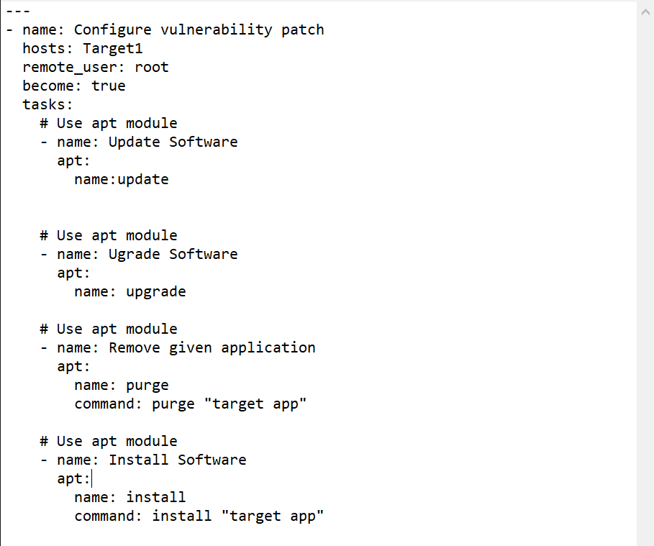
Implementing Patches with Ansible
Playbook Overview
Ansible is an efficient way for patching multiple
machines on a given network that have the same
vulnerability.
As seen by the sudo code on the right, this is a
general example on how to patch against high CPU usage.

